Slide 1
Summary Results Emissivity
23/08/2021

Slide 2
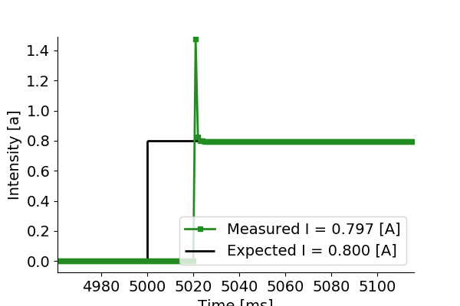
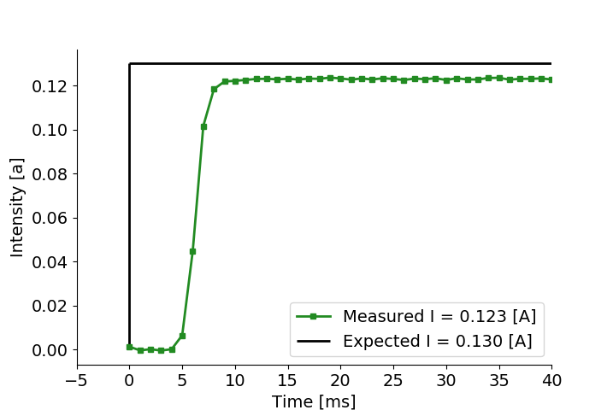
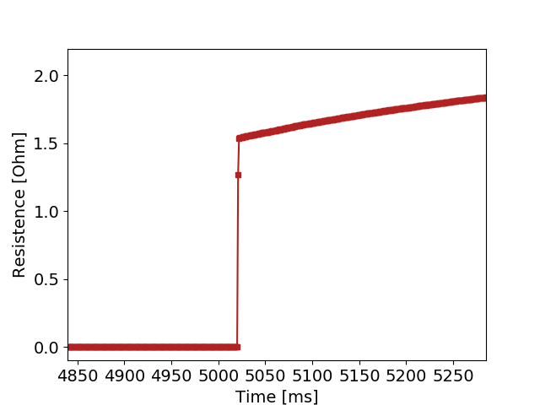
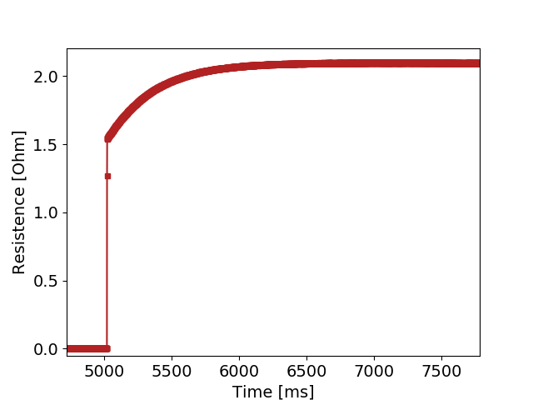
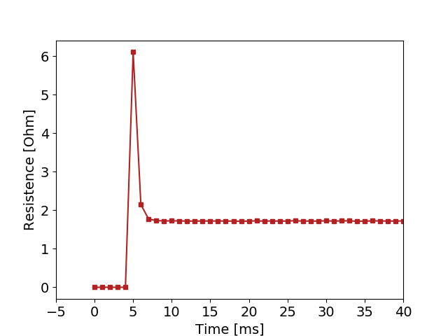
Current, Voltage, Resistance Measurements.
Example of R measurement. One can see, expected power load, Real power load, and measured R
Example of R0 measurement. One can see, expected power load, Real power load, and measured R0.
In this case, we can see an intensity overshoot, it is present wherever intensity starts being higher. Or always for R measurement? Not for R0…
If we ignore intensity overshoot, we clearly see the transient state of the resistance measuremetns.

Slide 3
Summary of R0 measurements
Summary of R measurements

